Slide 1
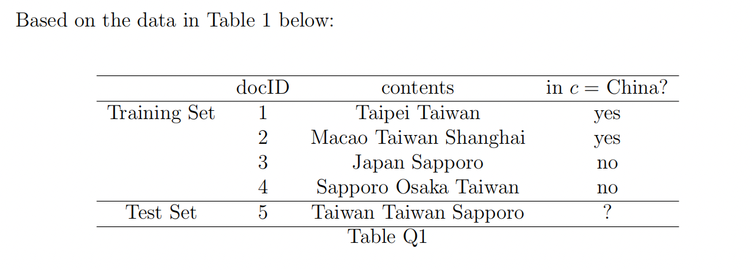
Tutorial 3 question3
Compute the tf-idf vector (normalized) representations of the documents in the table below. By using Rocchio Classication Algorithm to determine the class of the document.

Slide 2
Tutorial 3 question3
Step1: compute the tf-idf (normalized) for five documents
Step1.1: Compute the raw tf for five documents
 | raw tf
term | doc1 | doc2 | doc3 | doc4 | doc5
Taipei | 1 | 0 | 0 | 0 | 0
Taiwan | 1 | 1 | 0 | 1 | 2
Macao | 0 | 1 | 0 | 0 | 0
Shanghai | 0 | 1 | 0 | 0 | 0
Japan | 0 | 0 | 1 | 0 | 0
Sapporo | 0 | 0 | 1 | 1 | 1
Osaka | 0 | 0 | 0 | 1 | 0
There is no need to calculate weighted term frequency using the log frequency weighting method since the question does not explicitly ask for document weighting.

Slide 3
Tutorial 3 question3
Step1.2: Compute the df and idf for five documents, N=4 (the size of training set)
 | raw tf |  |  |  |  | df | idf
term | doc1 | doc2 | doc3 | doc4 | doc5
Taipei | 1 | 0 | 0 | 0 | 0 | 1 | 0.6
Taiwan | 1 | 1 | 0 | 1 | 2 | 3 | 0.1
Macao | 0 | 1 | 0 | 0 | 0 | 1 | 0.6
Shanghai | 0 | 1 | 0 | 0 | 0 | 1 | 0.6
Japan | 0 | 0 | 1 | 0 | 0 | 1 | 0.6
Sapporo | 0 | 0 | 1 | 1 | 1 | 2 | 0.3
Osaka | 0 | 0 | 0 | 1 | 0 | 1 | 0.6

Slide 4

Tutorial 3 question3
Step1.3: Compute the tf-idf (without normalization) for five documents
 | raw tf
term | doc1 | doc2 | doc3 | doc4 | doc5
Taipei | 1×0.6=0.6 | 0 | 0 | 0 | 0
Taiwan | 1×0.1=0.1 | 1 | 0 | 0.1 | 0.2
Macao | 0 | 0.6 | 0 | 0 | 0
Shanghai | 0 | 0.6 | 0 | 0 | 0
Japan | 0 | 0 | 0.6 | 0 | 0
Sapporo | 0 | 0 | 0.3 | 0.3 | 0.3
Osaka | 0 | 0 | 0 | 0.6 | 0

Slide 5
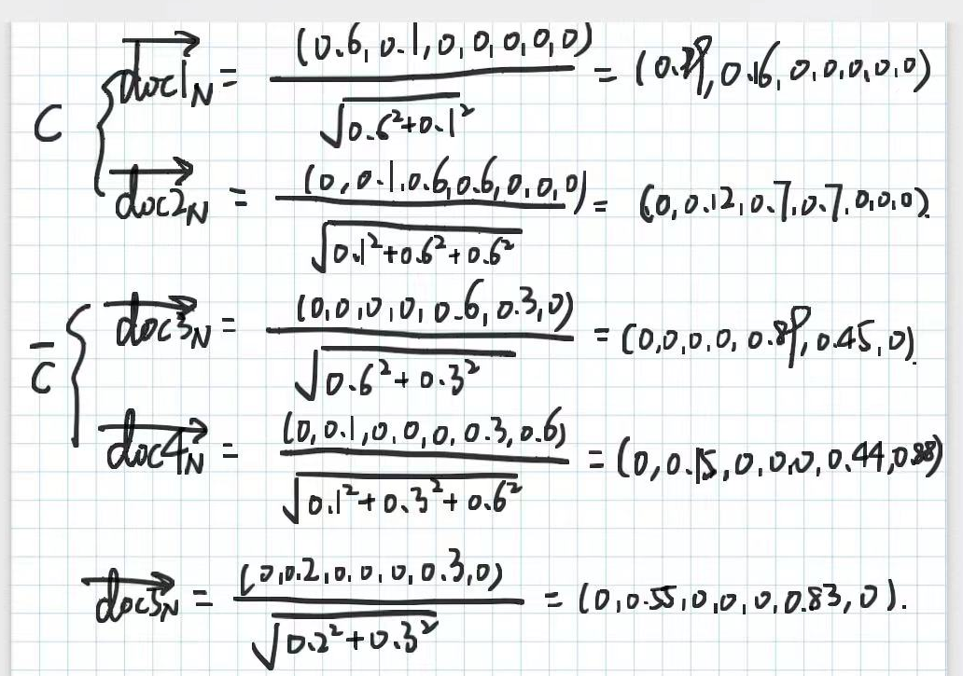
Tutorial 3 question3
Step1.3: Compute the tf-idf (with normalization) for five documents

Slide 6
Tutorial 3 question3
Step1.3: Compute the tf-idf (with normalization) for five documents
 | Taipei | Taiwan | Macao | Shanghai | Japan | Sapporo | Osaka
doc1 | 0.99 | 0.16 | 0 | 0 | 0 | 0 | 0
doc2 | 0 | 0.12 | 0.7 | 0.7 | 0 | 0 | 0
doc3 | 0 | 0 | 0 | 0 | 0.89 | 0.45 | 0
doc4 | 0 | 0.15 | 0 | 0 | 0 | 0.44 | 0.88
doc5 | 0 | 0.55 | 0 | 0 | 0 | 0.83 | 0

Slide 7
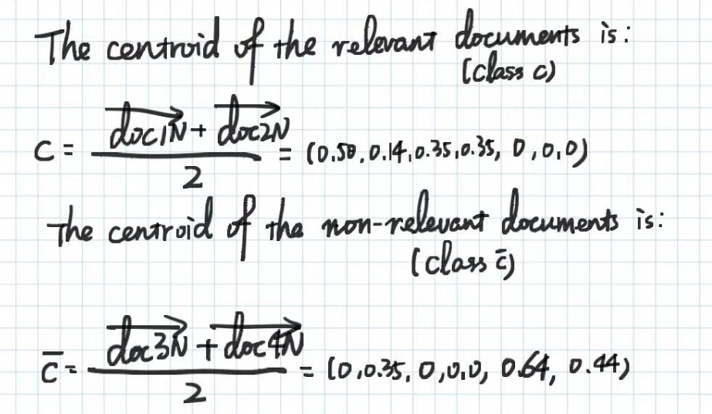


Tutorial 3 question3
Step2: Compute the centroid of class c and class not c
$${\vec{μ}}_{c}=\frac{1}{\left|D_{c}\right|}\sum_{d∈D_{c}}{\vec{d}}$$
Where D_{c} is the set of all documents that belong to class c and $\vec{d}$ is the vector space representation of document d.
(0,0.08,0,0,0.45,0.45,0.44)

Slide 8
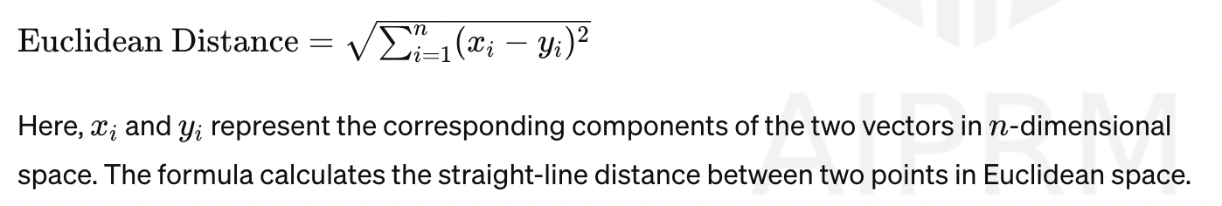
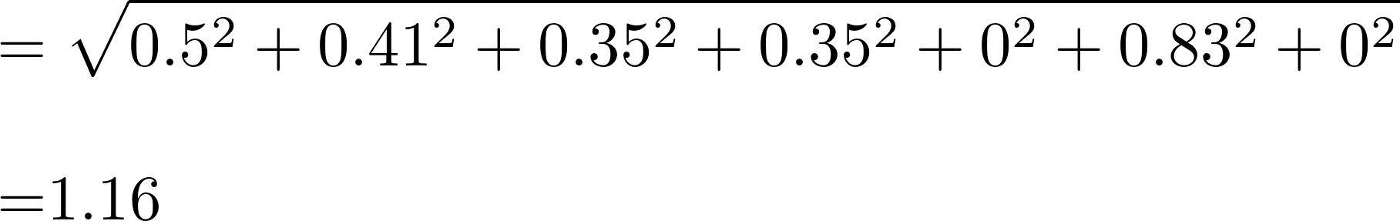
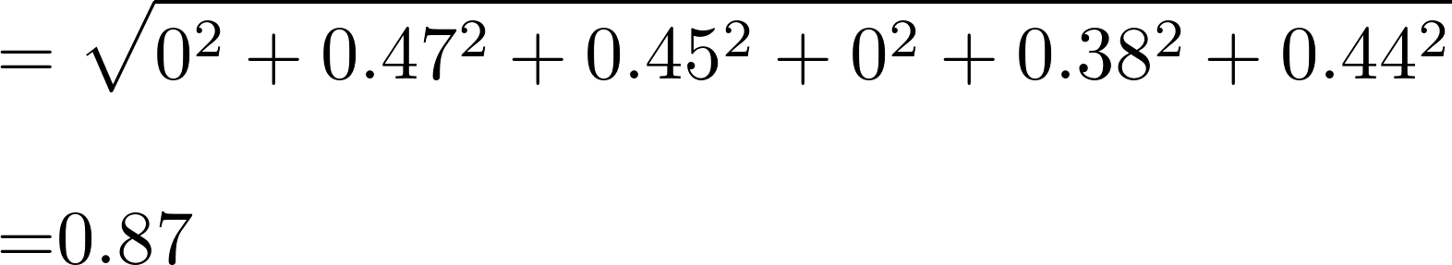

Tutorial 3 question3
Step3: Compute the distance between centroid and test data (We can use Euclidean Distance)
The distance from the query to the centroid c is:
the class of test document is not c

